Slide 1
Chapter Outline
Function and Structure of the FX Market
The Spot Market
The Forward Market
Function and Structure of the FX Market
The Spot Market
The Forward Market
Function and Structure of the FX Market
  FX Market Participants
  Correspondent Banking Relationships
The Spot Market
The Forward Market
Function and Structure of the FX Market
The Spot Market
  Spot Rate Quotations
  The Bid-Ask Spread
  Spot FX Trading
  Cross Exchange Rate Quotations
  Triangular Arbitrage
  Spot Foreign Exchange Market Microstructure
The Forward Market
Function and Structure of the FX Market
The Spot Market
The Forward Market
  Forward Rate Quotations
  Long and Short Forward Positions
  Forward Cross-Exchange Rates
  Swap Transactions
  Forward Premium

Slide 2
The Function and Structure of the FX Market
FX Market Participants
Correspondent Banking Relationships

Slide 3
FX Market Participants
The FX market is a two-tiered market:
  Interbank Market (Wholesale)
    About 700 banks worldwide stand ready to make a market in foreign exchange.
    Nonbank dealers account for about 20% of the market.
    There are FX brokers who match buy and sell orders but do not carry inventory and FX specialists.
  Client Market (Retail)
Market participants include international banks, their customers, nonbank dealers, FX brokers, and central banks.

Slide 4
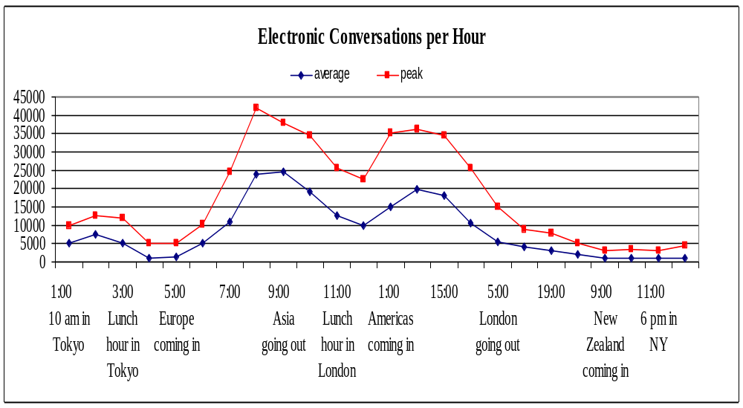
Circadian Rhythms of the FX Market
Notes:
Source:
Sam Y. Cross, All About the Foreign Exchange Market in the United States, Federal Reserve Bank of New York, www.ny.frb.org

Slide 5
Correspondent Banking Relationships
Large commercial banks maintain demand deposit accounts with one another which facilitates the efficient functioning of the FX market.

Slide 6
Correspondent Banking Relationships
Bank A is in London, Bank B is in New York.
The current exchange rate is £1.00 = $2.00.
A currency trader employed at Bank A buys £100m from a currency trader at Bank B for $200m settled using its correspondent relationship.
Bank A
London
$200
Bank B
NYC
£100

Slide 7
Correspondent Banking Relationships
Bank A
London
$200
Bank B
NYC
£100
Assets Liabilities
Assets Liabilities
£ deposit at B
£300m
B’s Deposit
$1,000m
$ deposit at A
$1000m
A’s Deposit
£300m
£400m
$1,200m
$1200m
£400m
$ deposit at B
$800m
B’s Deposit
£200m
£ deposit at A
£200m
A’s Deposit
$800m
$600m
£100m
£100m
$600m
Other Assets
£600m
Other L&E
£600m
Other Assets
$800m
Other L&E
$800m
Total Assets
£1,300m
Total L&E
£1,300m
Total Assets
$2,200m
Total L&E
$2,200m

Slide 8
Correspondent Banking Relationships
International commercial banks communicate with one another with:
  SWIFT: The Society for Worldwide Interbank Financial Telecommunications.
  CHIPS: Clearing House Interbank Payments System
  ECHO Exchange Clearing House Limited, the first global clearinghouse for settling interbank FX transactions.

Slide 9
The Spot Market
Spot Rate Quotations
The Bid-Ask Spread
Spot FX trading
Cross Rates

Slide 10
Spot Rate Quotations
Direct quotation
  the U.S. dollar equivalent
  e.g. “a Japanese Yen is worth about a penny”
Indirect Quotation
  the price of a U.S. dollar in the foreign currency
  e.g. “you get 100 yen to the dollar”
See the insert card from your textbook.

Slide 11
Spot Rate Quotations
Country | USD equiv Friday | USD equiv Thursday | Currency per USD Friday | Currency per USD Thursday
Argentina (Peso) | 0.3309 | 0.3292 | 3.0221 | 3.0377
Australia (Dollar) | 0.7830 | 0.7836 | 1.2771 | 1.2762
Brazil (Real) | 0.3735 | 0.3791 | 2.6774 | 2.6378
Britain (Pound) | 1.9077 | 1.9135 | 0.5242 | 0.5226
1 Month Forward | 1.9044 | 1.9101 | 0.5251 | 0.5235
3 Months Forward | 1.8983 | 1.9038 | 0.5268 | 0.5253
6 Months Forward | 1.8904 | 1.8959 | 0.5290 | 0.5275
Canada (Dollar) | 0.8037 | 0.8068 | 1.2442 | 1.2395
1 Month Forward | 0.8037 | 0.8069 | 1.2442 | 1.2393
3 Months Forward | 0.8043 | 0.8074 | 1.2433 | 1.2385
6 Months Forward | 0.8057 | 0.8088 | 1.2412 | 1.2364

Slide 12
Spot Rate Quotations
Country | USD equiv Friday | USD equiv Thursday | Currency per USD Friday | Currency per USD Thursday
Argentina (Peso) | 0.3309 | 0.3292 | 3.0221 | 3.0377
Australia (Dollar) | 0.7830 | 0.7836 | 1.2771 | 1.2762
Brazil (Real) | 0.3735 | 0.3791 | 2.6774 | 2.6378
Britain (Pound) | 1.9077 | 1.9135 | 0.5242 | 0.5226
1 Month Forward | 1.9044 | 1.9101 | 0.5251 | 0.5235
3 Months Forward | 1.8983 | 1.9038 | 0.5268 | 0.5253
6 Months Forward | 1.8904 | 1.8959 | 0.5290 | 0.5275
Canada (Dollar) | 0.8037 | 0.8068 | 1.2442 | 1.2395
1 Month Forward | 0.8037 | 0.8069 | 1.2442 | 1.2393
3 Months Forward | 0.8043 | 0.8074 | 1.2433 | 1.2385
6 Months Forward | 0.8057 | 0.8088 | 1.2412 | 1.2364
The direct quote for British pound is:
£1 = $1.9077

Slide 13
Spot Rate Quotations
Country | USD equiv Friday | USD equiv Thursday | Currency per USD Friday | Currency per USD Thursday
Argentina (Peso) | 0.3309 | 0.3292 | 3.0221 | 3.0377
Australia (Dollar) | 0.7830 | 0.7836 | 1.2771 | 1.2762
Brazil (Real) | 0.3735 | 0.3791 | 2.6774 | 2.6378
Britain (Pound) | 1.9077 | 1.9135 | 0.5242 | 0.5226
1 Month Forward | 1.9044 | 1.9101 | 0.5251 | 0.5235
3 Months Forward | 1.8983 | 1.9038 | 0.5268 | 0.5253
6 Months Forward | 1.8904 | 1.8959 | 0.5290 | 0.5275
Canada (Dollar) | 0.8037 | 0.8068 | 1.2442 | 1.2395
1 Month Forward | 0.8037 | 0.8069 | 1.2442 | 1.2393
3 Months Forward | 0.8043 | 0.8074 | 1.2433 | 1.2385
6 Months Forward | 0.8057 | 0.8088 | 1.2412 | 1.2364
The indirect quote for British pound is:
£.5242 = $1

Slide 14
Spot Rate Quotations
Country | USD equiv Friday | USD equiv Thursday | Currency per USD Friday | Currency per USD Thursday
Argentina (Peso) | 0.3309 | 0.3292 | 3.0221 | 3.0377
Australia (Dollar) | 0.7830 | 0.7836 | 1.2771 | 1.2762
Brazil (Real) | 0.3735 | 0.3791 | 2.6774 | 2.6378
Britain (Pound) | 1.9077 | 1.9135 | 0.5242 | 0.5226
1 Month Forward | 1.9044 | 1.9101 | 0.5251 | 0.5235
3 Months Forward | 1.8983 | 1.9038 | 0.5268 | 0.5253
6 Months Forward | 1.8904 | 1.8959 | 0.5290 | 0.5275
Canada (Dollar) | 0.8037 | 0.8068 | 1.2442 | 1.2395
1 Month Forward | 0.8037 | 0.8069 | 1.2442 | 1.2393
3 Months Forward | 0.8043 | 0.8074 | 1.2433 | 1.2385
6 Months Forward | 0.8057 | 0.8088 | 1.2412 | 1.2364
Note that the direct quote is the reciprocal of the indirect quote:
1
1
.
9077
=
.
5242

Slide 15
The Bid-Ask Spread
The bid price is the price a dealer is willing to pay you for something.
The ask price is the amount the dealer wants you to pay for the thing.
The bid-ask spread is the difference between the bid and ask prices.

Slide 16
The Bid-Ask Spread
A dealer could offer
  bid price of $1.25 per €
  ask price of $1.26 per €
  While there are a variety of ways to quote that,
The bid-ask spread represents the dealer’s expected profit.

Slide 17
The Bid-Ask Spread
big figure
small figure
Bid
Ask
S($/£)
1.9072
1.9077
S(£/$)
.5242
.5243
A dealer would likely quote these prices as 72-77.
It is presumed that anyone trading $10m already knows the “big figure”.

Slide 18
Spot FX trading
In the interbank market, the standard size trade is about U.S. $10 million.
A bank trading room is a noisy, active place.
The stakes are high.
The “long term” is about 10 minutes.

Slide 19
Cross Rates
Suppose that S($/€) = 1.50
  i.e. $1.50 = €1.00
and that S(¥/€) = 50
  i.e. €1.00 = ¥50
What must the $/¥ cross rate be?
$1.50
€1.00
$1.50
×
=
€1.00
¥50
¥50
$1.00 = ¥33.33
$0.0300 = ¥1

Slide 20
Triangular Arbitrage
Suppose we observe these banks posting these exchange rates.
$
Barclays
S(¥/$)=120
Credit Lyonnais
S(£/$)=1.50
¥
Credit Agricole
S(¥/£)=85
First calculate any implied cross rate to see if an arbitrage exists.
£
£1.50
$1.00
£1.00
×
=
$1.00
¥120
¥80

Slide 21
Triangular Arbitrage
The implied S(¥/£) cross rate is
$
£1.50
$1.00
£1.00
×
=
Barclays
S(¥/$)=120
$1.00
¥120
¥80
Credit Lyonnais
S(£/$)=1.50
Credit Agricole has posted a quote of S(¥/£)=85 so there is an arbitrage opportunity.
¥
Credit Agricole
S(¥/£)=85
£
Buy the £ @ ¥80; sell @ ¥85.
So, how can we make money?
Then trade yen for your preferred currency.

Slide 22
Triangular Arbitrage
As easy as 1 – 2 – 3:
$
$
1. Sell our $ for £,
2. Sell our £ for ¥,
3. Sell those ¥ for $.
Barclays
S(¥/$)=120
Credit Lyonnais
S(£/$)=1.50
3
1
2
¥
Credit Agricole
S(¥/£)=85
£

Slide 23
Triangular Arbitrage
Sell $100,000 for £ at S(£/$) = 1.50
receive £150,000
Sell our £150,000 for ¥ at S(¥/£) = 85
receive ¥12,750,000
Sell ¥12,750,000 for $ at S(¥/$) = 120
receive $106,250
profit per round trip = $106,250 – $100,000 = $6,250

Slide 24
Triangular Arbitrage
Here we have to go “clockwise” to make money—but it doesn’t matter where we start.
$
$
Barclays
S(¥/$)=120
Credit Lyonnais
S(£/$)=1.50
2
3
1
¥
Credit Agricole
S(¥/£)=85
£
If we went “counter clockwise” we would be the source of arbitrage profits, not the recipient!

Slide 25
Spot Foreign Exchange Microstructure
Market Microstructure refers to the mechanics of how a marketplace operates.
Bid-Ask spreads in the spot FX market:
  increase with FX exchange rate volatility and
  decrease with dealer competition.
Private information is an important determinant of spot exchange rates.

Slide 26
The Forward Market
Forward Rate Quotations
Long and Short Forward Positions
Forward Cross Exchange Rates
Swap Transactions
Forward Premium

Slide 27
The Forward Market
A forward contract is an agreement to buy or sell an asset in the future at prices agreed upon today.
If you have ever had to order an out-of-stock textbook, then you have entered into a forward contract.

Slide 28
Forward Rate Quotations
The forward market for FX involves agreements to buy and sell foreign currencies in the future at prices agreed upon today.
Bank quotes for 1, 3, 6, 9, and 12 month maturities are readily available for forward contracts.
Longer-term swaps are available.

Slide 29
Forward Rate Quotations
Consider the example from above:
for British pounds, the spot rate is
$1.9077 = £1.00
While the 180-day forward rate is
$1.8904 = £1.00
What’s up with that?

Slide 30
Spot Rate Quotations
Country | USD equiv Friday | USD equiv Thursday | Currency per USD Friday | Currency per USD Thursday
Argentina (Peso) | 0.3309 | 0.3292 | 3.0221 | 3.0377
Australia (Dollar) | 0.7830 | 0.7836 | 1.2771 | 1.2762
Brazil (Real) | 0.3735 | 0.3791 | 2.6774 | 2.6378
Britain (Pound) | 1.9077 | 1.9135 | 0.5242 | 0.5226
1 Month Forward | 1.9044 | 1.9101 | 0.5251 | 0.5235
3 Months Forward | 1.8983 | 1.9038 | 0.5268 | 0.5253
6 Months Forward | 1.8904 | 1.8959 | 0.5290 | 0.5275
Canada (Dollar) | 0.8037 | 0.8068 | 1.2442 | 1.2395
1 Month Forward | 0.8037 | 0.8069 | 1.2442 | 1.2393
3 Months Forward | 0.8043 | 0.8074 | 1.2433 | 1.2385
6 Months Forward | 0.8057 | 0.8088 | 1.2412 | 1.2364
Clearly the market participants expect that the pound will be worth less in dollars in six months.

Slide 31
Forward Rate Quotations
Consider the (dollar) holding period return of a dollar-based investor who buys £1 million at the spot and sells them forward:
gain
$1,890,400 – $1,907,700
–$17,300
$HPR=
=
=
pain
$1,907,700
$1,907,700
$HPR = –0.0091
Annualized dollar HPR = –1.81% = –0.91% × 2

Slide 32
Forward Premium
The interest rate differential implied by forward premium or discount.
For example, suppose the € is appreciating from S($/€) = 1.25 to F₁₈₀($/€) = 1.30
The 180-day forward premium is given by:
F₁₈₀($/€) – S($/€)
360
1.30 – 1.25
f_{180,€v$}
=
×
=
× 2
= 0.08
S($/€)
180
1.25

Slide 33
Long and Short Forward Positions
If you have agreed to sell anything (spot or forward), you are “short”.
If you have agreed to buy anything (forward or spot), you are “long”.
If you have agreed to sell FX forward, you are short.
If you have agreed to buy FX forward, you are long.

Slide 34
Payoff Profiles
profit
If you agree to sell anything in the future at a set price and the spot price later falls then you gain.
S₁₈₀($/¥)
0
F₁₈₀($/¥) = .009524
If you agree to sell anything in the future at a set price and the spot price later rises then you lose.
loss
Short position

Slide 35
Payoff Profiles
profit
short position
Whether the payoff profile slopes up or down depends upon whether you use the direct or indirect quote:
F₁₈₀(¥/$) = 105 or F₁₈₀($/¥) = .009524.
0
S₁₈₀(¥/$)
F₁₈₀(¥/$) = 105
-F₁₈₀(¥/$)
loss

Slide 36
Payoff Profiles
profit
short position
S₁₈₀(¥/$)
0
F₁₈₀(¥/$) = 105
When the short entered into this forward contract, he agreed to sell ¥ in 180 days at F₁₈₀(¥/$) = 105
-F₁₈₀(¥/$)
loss

Slide 37
Payoff Profiles
profit
short position
15¥
S₁₈₀(¥/$)
0
120
F₁₈₀(¥/$) = 105
If, in 180 days, S₁₈₀(¥/$) = 120, the short will make a profit by buying ¥ at S₁₈₀(¥/$) = 120 and delivering ¥ at F₁₈₀(¥/$) = 105.
-F₁₈₀(¥/$)
loss

Slide 38
Payoff Profiles
profit
Since this is a zero-sum game, the long position payoff is the opposite of the short.
short position
F₁₈₀(¥/$)
S₁₈₀(¥/$)
0
F₁₈₀(¥/$) = 105
-F₁₈₀(¥/$)
Long position
loss

Slide 39
Payoff Profiles
profit
The long in this forward contract agreed to BUY ¥ in 180 days at F₁₈₀(¥/$) = 105
-F₁₈₀(¥/$)
If, in 180 days, S₁₈₀(¥/$) = 120, the long will lose by having to buy ¥ at S₁₈₀(¥/$) = 120 and delivering ¥ at F₁₈₀(¥/$) = 105.
S₁₈₀(¥/$)
0
120
F₁₈₀(¥/$) = 105
–15¥
Long position
loss

Slide 40
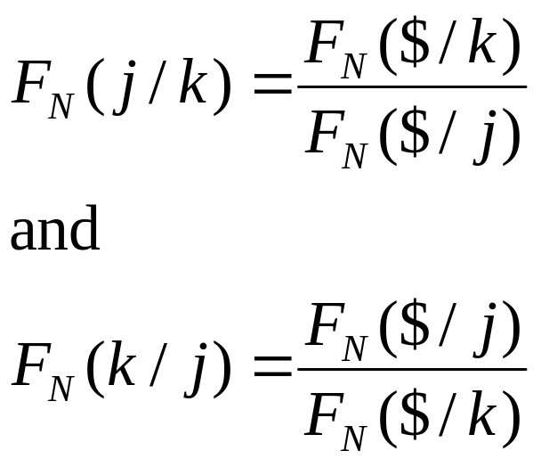
Forward Cross Exchange Rates
It’s just an “delayed” example of the spot cross rate discussed above.
In generic terms
Notice that the “$”s cancel.

Slide 41
Forward Cross Exchange Rates
Country | USD equiv Friday | USD equiv Thursday | Currency per USD Friday
Argentina (Peso) | 0.3309 | 0.3292 | 3.0221
Australia (Dollar) | 0.7830 | 0.7836 | 1.2771
Brazil (Real) | 0.3735 | 0.3791 | 2.6774
Britain (Pound) | 1.9077 | 1.9135 | 0.5242
1 Month Forward | 1.9044 | 1.9101 | 0.5251
3 Months Forward | 1.8983 | 1.9038 | 0.5268
6 Months Forward | 1.8904 | 1.8959 | 0.5290
Canada (Dollar) | 0.8037 | 0.8068 | 1.2442
1 Month Forward | 0.8037 | 0.8069 | 1.2442
3 Months Forward | 0.8043 | 0.8074 | 1.2433
6 Months Forward | 0.8057 | 0.8088 | 1.2412
The forward
pound-Canadian dollar cross rate
GBP1.00
USD1.00
×
USD1.8904
CAD1.2412
GBP1.00
=
CAD2.3464

Slide 42
Currency Symbols
In addition to the familiar currency symbols (e.g. £, ¥, €, $) there are three-letter codes for all currencies.
It is a long list, but selected codes include:
CHF Swiss francs
GBP British pound
ZAR South African rand
CAD Canadian dollar
JPY Japanese yen

Slide 43
SWAPS
A swap is an agreement to provide a counterparty with something he wants in exchange for something that you want.
  Often on a recurring basis—e.g. every six months for five years.
Swap transactions account for approximately 56 percent of interbank FX trading, whereas outright trades are 11 percent.
Swaps are covered fully in chapter 14.

Slide 44
Summary
Spot rate quotations
  Direct and indirect quotes
  Bid and ask prices
Cross Rates
  Triangular arbitrage
Forward Rate Quotations
  Forward premium (discount)
  Forward points

Slide 45
Practice Problem
The current spot exchange rate is $1.55/£ and the three-month forward rate is $1.50/£. Based on your analysis of the exchange rate, you are confident that the spot exchange rate will be $1.52/£ in three months. Assume that you would like to buy or sell £1,000,000.
a. What actions do you need to take to speculate in the forward market? What is the expected dollar profit from speculation?
b. What would be your speculative profit in dollar terms if the spot exchange rate actually turns out to be $1.46/£?
c. Graph your results.

Slide 46
Solution
a. If you believe the spot exchange rate will be $1.52/£ in three months, you should buy £1,000,000 forward for $1.50/£. Your expected profit will be:
$20,000 = £1,000,000 × ($1.52 – $1.50)
b. If the spot exchange rate actually turns out to be $1.46/£ in three months, your loss from the long position will be:
–$40,000 = £1,000,000 × ($1.46 – $1.50)

Slide 47
Solution
profit
$20k
0
S₁₈₀(£/$)
1.46
1.52
F₁₈₀(£/$) = 1.50
–$40k
loss

Slide 48
End Chapter Five

